Slide 1
IBN for Whole-of-System Automation
Chris Janz
Huawei
ETSI ZSM – IRTF NMRG Joint Meeting, November 9, 2024 Dublin

Slide 2
Key references
IRTF:
RFC 9315 Intent-Based Networking: Concepts and Definitions
RFC 9316: Intent Classification
Coming (draft): Use Cases and Practices for Intent-Based Networking
ETSI ZSM:
ETSI GR ZSM 011: Intent-driven autonomous networks: Generic aspects
ETSI GS ZSM 016: Intent-driven closed loops

Slide 3
Key aspects in common
Consumer
(Requesting System)
Provider
(Delivering System)
Intent (Declarative)
Reports
Translation
Assurance CL

Slide 4
Additional aspects from ZSM
Intent LCM
Interface operations supporting intent LCM
Consumer
(Requesting System)
Provider
(Delivering System)
Intent (Declarative)
Reports
Translation
Assurance CL

Slide 5
Corollaries: Whole-of-System Automation
The consumer is strictly a “demand system”
It plays no role in network operations
Intent is declarative as a consequence
Receives only reports indicating intent compliance or lack of it
Reaction to reports limited to LC responses
This creates a strict role separation between consumer and producer
As is generally characteristic of the role separation between buyers and vendors
It also enables whole-of-system, top-to-bottom automation
consumer-vendor interaction may be automated by automating intent LC decision-making
delivery is automated by assurance closed loop
Intent is the functional target for major system interfaces in automated systems
Directly between automated, intelligent network and demand generation/management systems
Intent is a set of mechanisms working in concert, not a model
Any appropriately abstracted model may be compatible with use in an intent-based system

Slide 6
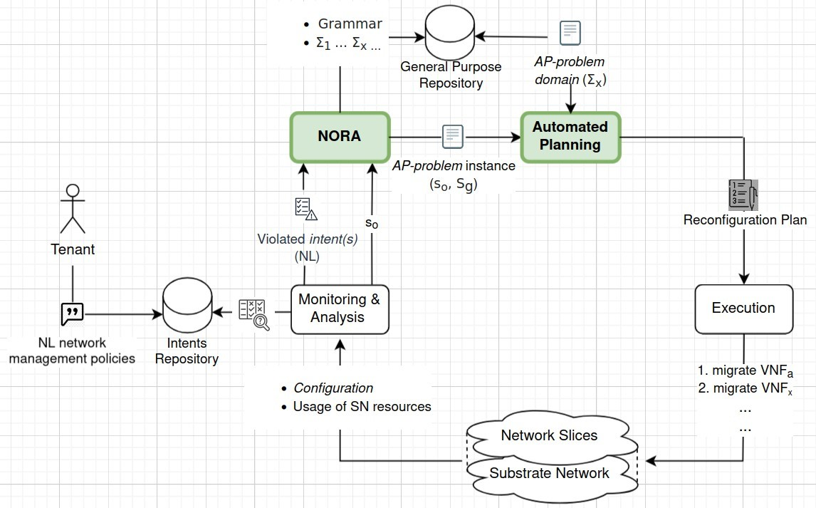
Assurance Closed Loops in IBNs
E.g. from: “An Autonomic Control Loop with AI-planning and NLP for achieving self-reconfiguration in a sliced network”
(Angela Vivas et al, presented in NMRG session IETF 121)
“Outer Closed Loop”
NDTs can be used here…

Slide 7
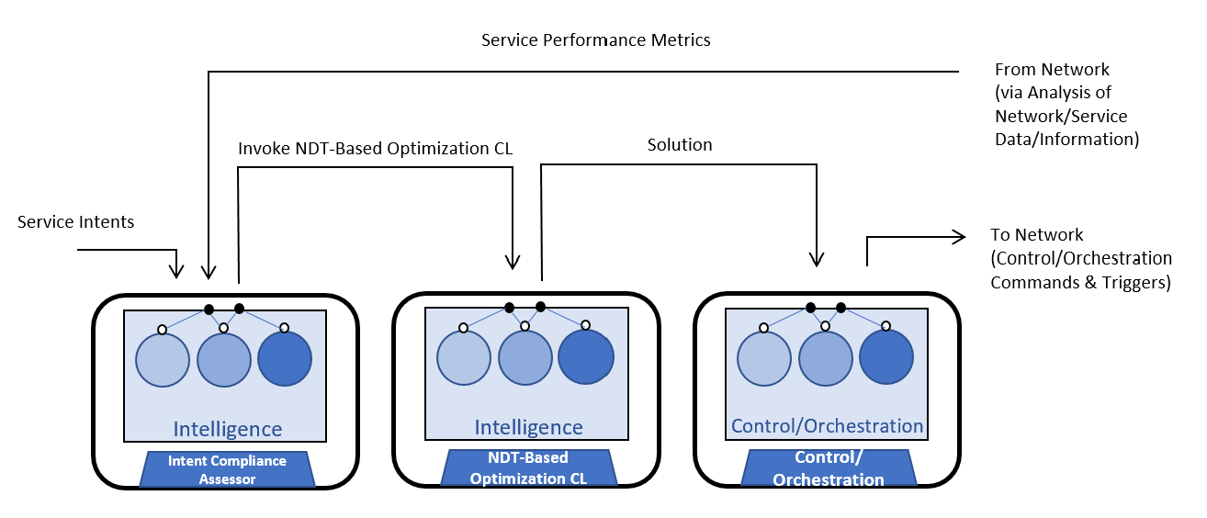
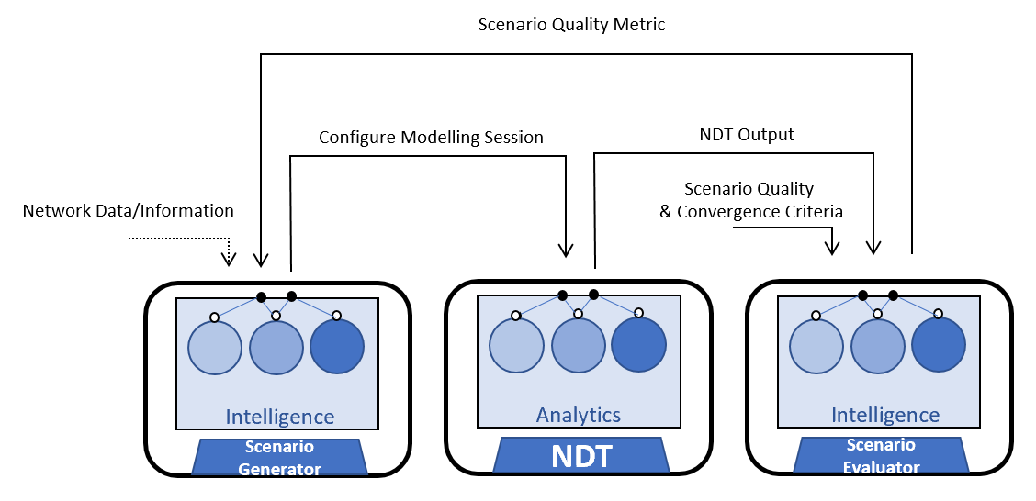
From ZSM 016: NDT-Based Inner Closed Loop
“Outer Closed Loop”
“Inner Closed Loop”
(An instance of an NDT-based optimization CL)

Slide 8
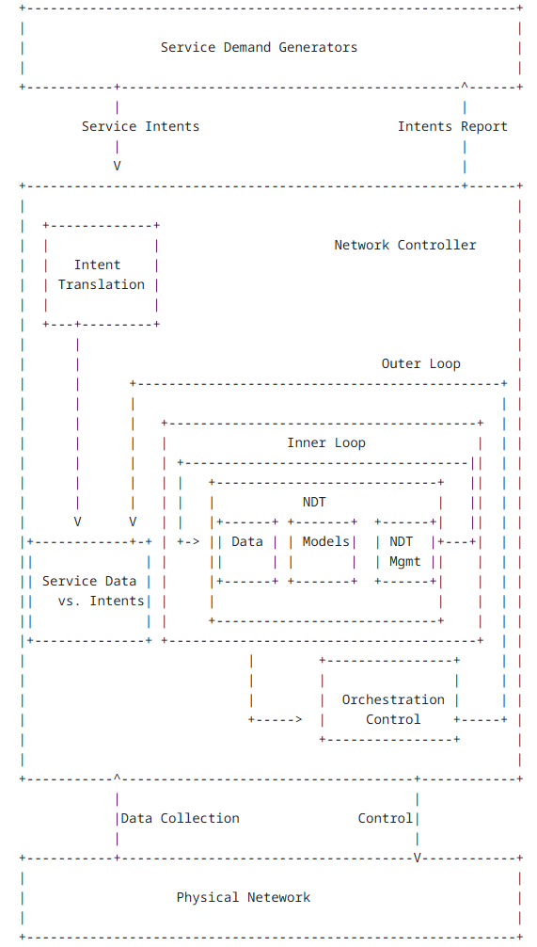
From NMRG C&A Draft
https://datatracker.ietf.org/doc/draft-irtf-nmrg-network-digital-twin-arch/

